Slide 1
Journal Club
EValuation Of Cinacalcet HCl Therapy to Lower CardioVascular
Events – EVOLVE
NEJM Dec 2012
Yuvaraj Thangaraj, M.D.
Nephrology Fellow
Division of Nehrology, Hypertension and Renal Transplantation

Slide 2
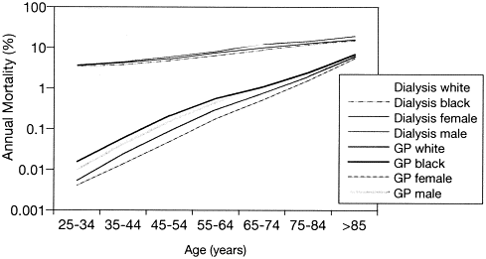
Cardiovascular mortality in dialysis patients
Am J Kidney Dis, 32 (suppl 3) (1998), pp. S112–S119

Slide 3
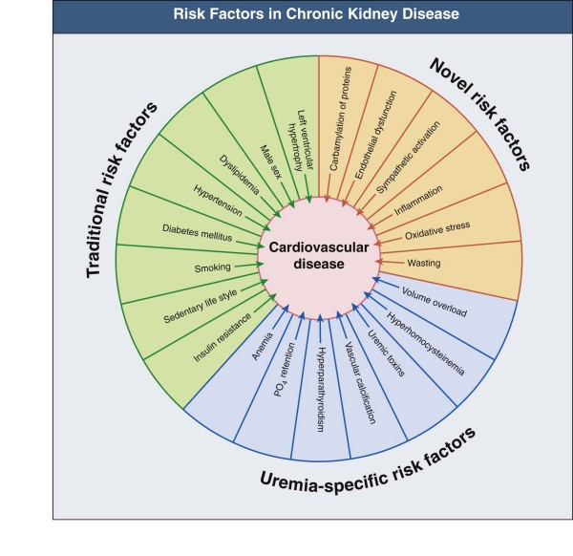
Peter Stenvinkel, Charles A. Herzog, Ch. 78,
Comphrehensive Clinical Nephrology,

Slide 4
Background
Secondary HPT is a common and serious disease that develops early in chronic kidney disease (CKD) (glomerular filtration rate [GFR] ≤ 60 mL/min) before the initiation of dialysis and progresses as patients reach end stage renal disease (ESRD)
Traditional therapy (vitamin D and phosphate binders) is inadequate for many patients with CKD and, at times, can even aggravate the complications of the Disease
vitamin D sterols are effective in reducing PTH levels, they are limited by the development of hypercalcemia and hyperphosphatemia due to enhanced gastrointestinal absorption

Slide 5
AJKD June 2000
USRDS 2000
40% of dialysis patients have elevated intact PTH levels (> 300 pg/mL)
10% of patients have PTH levels > 800 pg/mL
Over 50% of dialysis patients have phosphorus and calcium-phosphorus product (Ca x P) levels above ranges recommended by international guidelines
less than 8% of dialysis patients receiving traditional therapy meet NKF-K/DOQI guideline ranges concurrently for all 4 measures

Slide 6
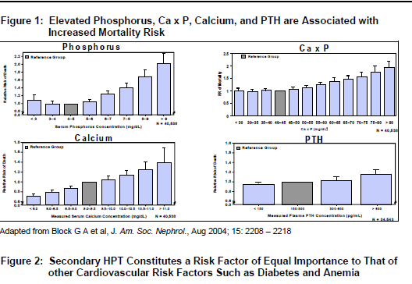
Elevated Phosphorus Ca x P, Calcium, and PTH are Associated with
Increased Mortality Risk

Slide 7
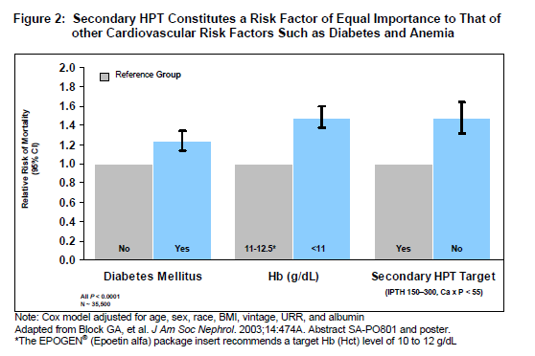
Secondary HPT constitute a Risk Factor of Equal Importance to That of other
Cardiovascular Risk Factors Such as Diabetes and Anemia

Slide 8
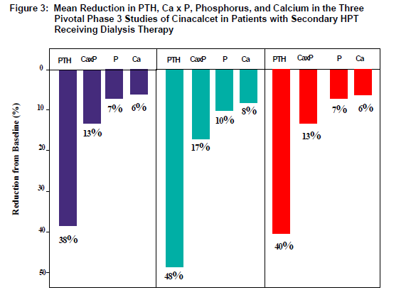
Cinacalcet
Cinacalcet was approved in 2004 for secondary hyperparathyroidism
Phase 3 studies of Cinacalcet

Slide 9
Reduction in the risk of cardiovascular events and fracture and a marked
reduction in the rate of parathyroidectomy

Slide 10
EValuation Of Cinacalcet HCl Therapy to Lower CardioVascular Events – EVOLVE
Objective
To test the hypothesis that treatment with Cinacalcet would reduce the risks of death and non fatal Cardiovascular events among patients with secondary hyperparathyroidism

Slide 11
Study Oversight
The study was sponsored by Amgen
Trial design and operation was supervised by executive committee led my
academic investigators
Safety data and interim analyses were monitored by independent data monitoring
Committee
The statistical analysis were verified by independent statisticians at Frontier Science

Slide 12
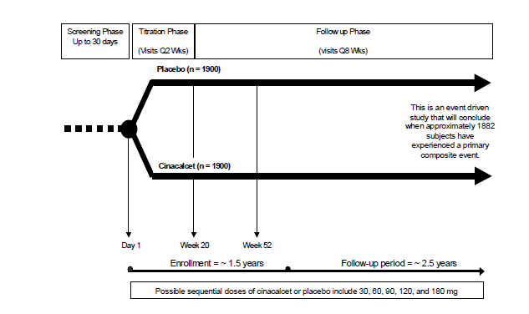
Study Design
multicenter, randomized, prospective, double-blind, placebo controlled study

Slide 13
3883 adult patients undergoing HD
(All patients were eligible to receive Conventional therapy including Phos binders , Vitamin D sterols, or both)
Cinacalcet 30 mg daily
Patients were eligible for dose escalation once every 4 weeks during a 20 week escalation phase or every 8 week during follow-up
Placebo
Patients were eligible for conventional therapy

Slide 14
STUDY ENDPOINTS
Primary Endpoint
Time to the composite event comprising all-cause mortality and non-fatal cardiovascular events (MI, hospitalization for unstable angina, HF, or peripheral vascular event)
Secondary Endpoints
Time to all-cause mortality
Time to cardiovascular mortality
Time to fatal and non-fatal MI
Time to fatal and non-fatal hospitalization for unstable angina
Time to fatal and non-fatal HF event
Time to fatal and non-fatal peripheral vascular event
Time to Parathyroidectomy
Time to fracture

Slide 15
Statistical Analysis
Sample size calculation
Sample size was calculated on the basis of an annual rate of primary composite end point
Of 23.5% in the placebo group, a 20% treatment effect, a 1.5 year enrollment period,
a 4 year total study duration, an annual rate of loss to follow up of 1% and a drop out
rate of 10%
Intention-to-treat principle
All data were collected and analyzed in accordance with intention-to-treat principle
Kaplan-Meier product limit estimates
For the time to the primary event
Two sided Log rank test
For comparing groups
Cox-proportional hazard regression model
For relative hazard and 95% confidence interval

Slide 16
Lag Censoring Analyses
Data were censored 6 months after patient stopped using the study drug(with the
Presumption that the effect lasts for 6 months after discontinuation)
Transplantation
Parathyroidectomy

Slide 17
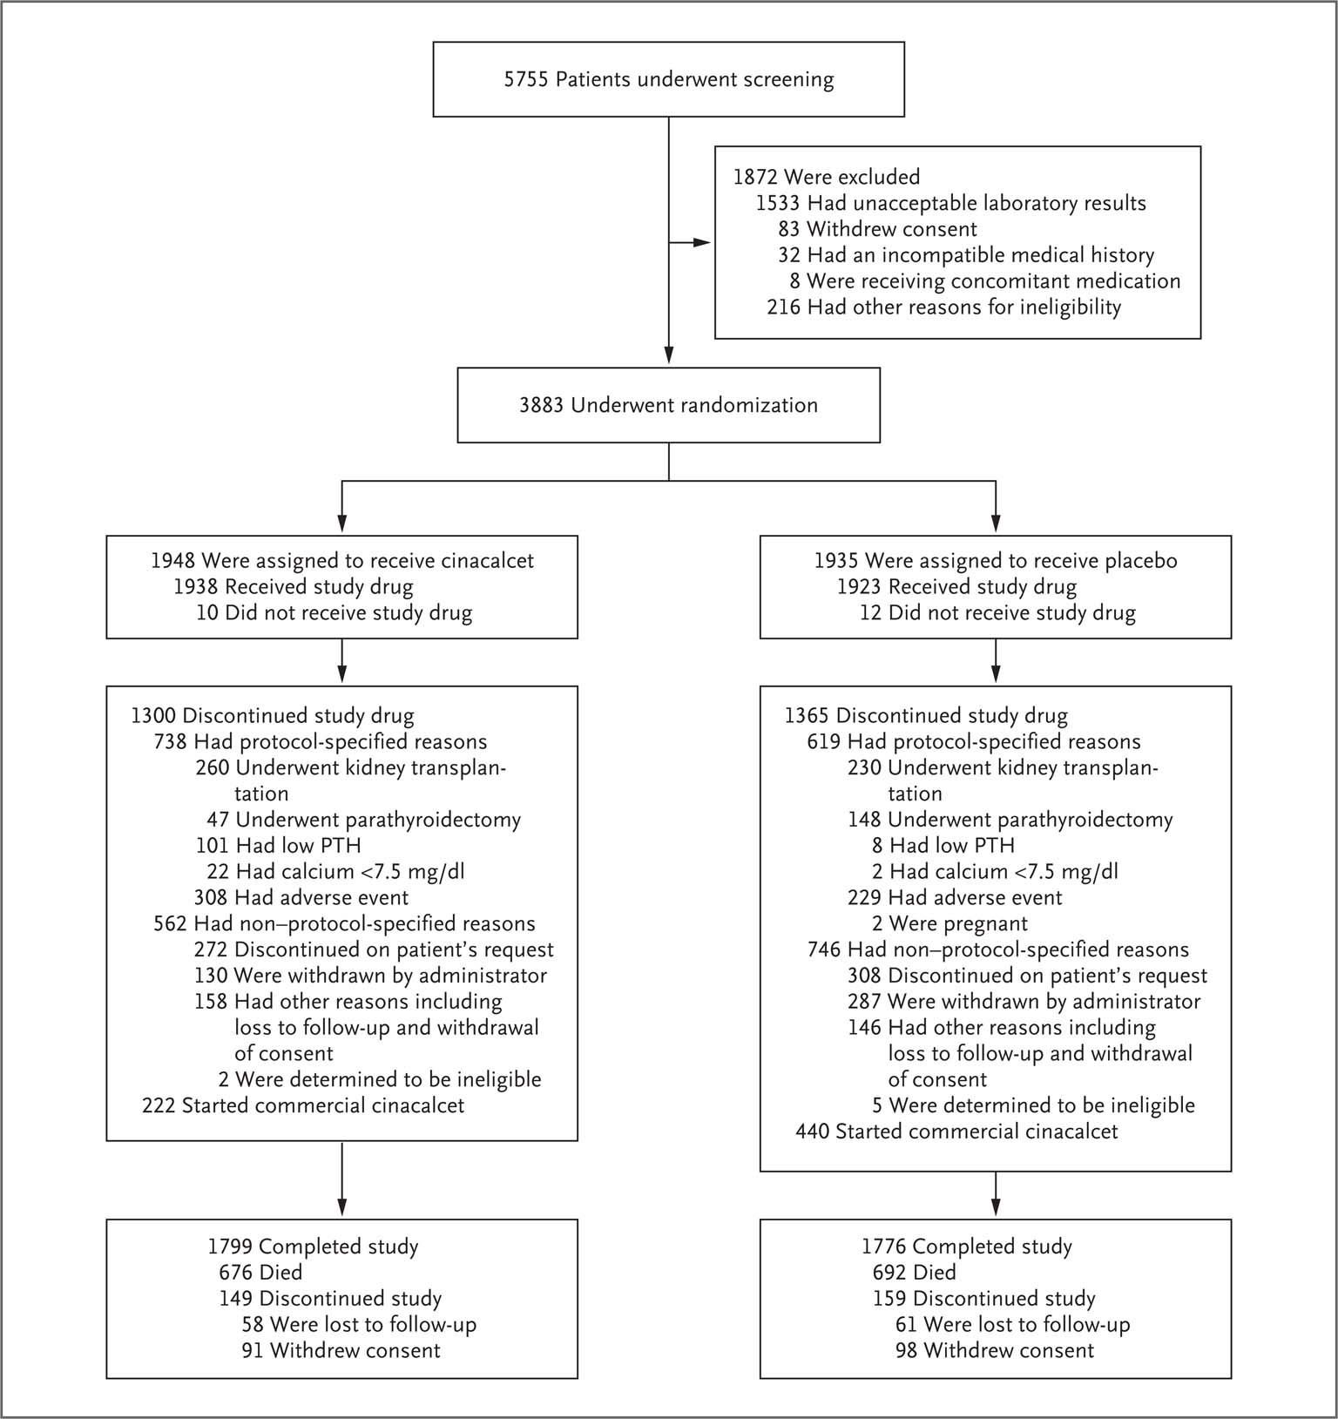
Enrolment and Outcomes
The EVOLVE Trial Investigators. N Engl J Med 2012;367:2482-2494
Notes:
Figure 1 Enrollment and Outcomes. Among patients who discontinued participation in the study, in the cinacalcet group, 28 deaths were reported in a search of vital status, and 37 patients had unknown vital status at the time of study termination. In the placebo group, 34 deaths were reported in a search of vital status, and 43 patients had unknown vital status at study termination. PTH denotes parathyroid hormone.

Slide 18
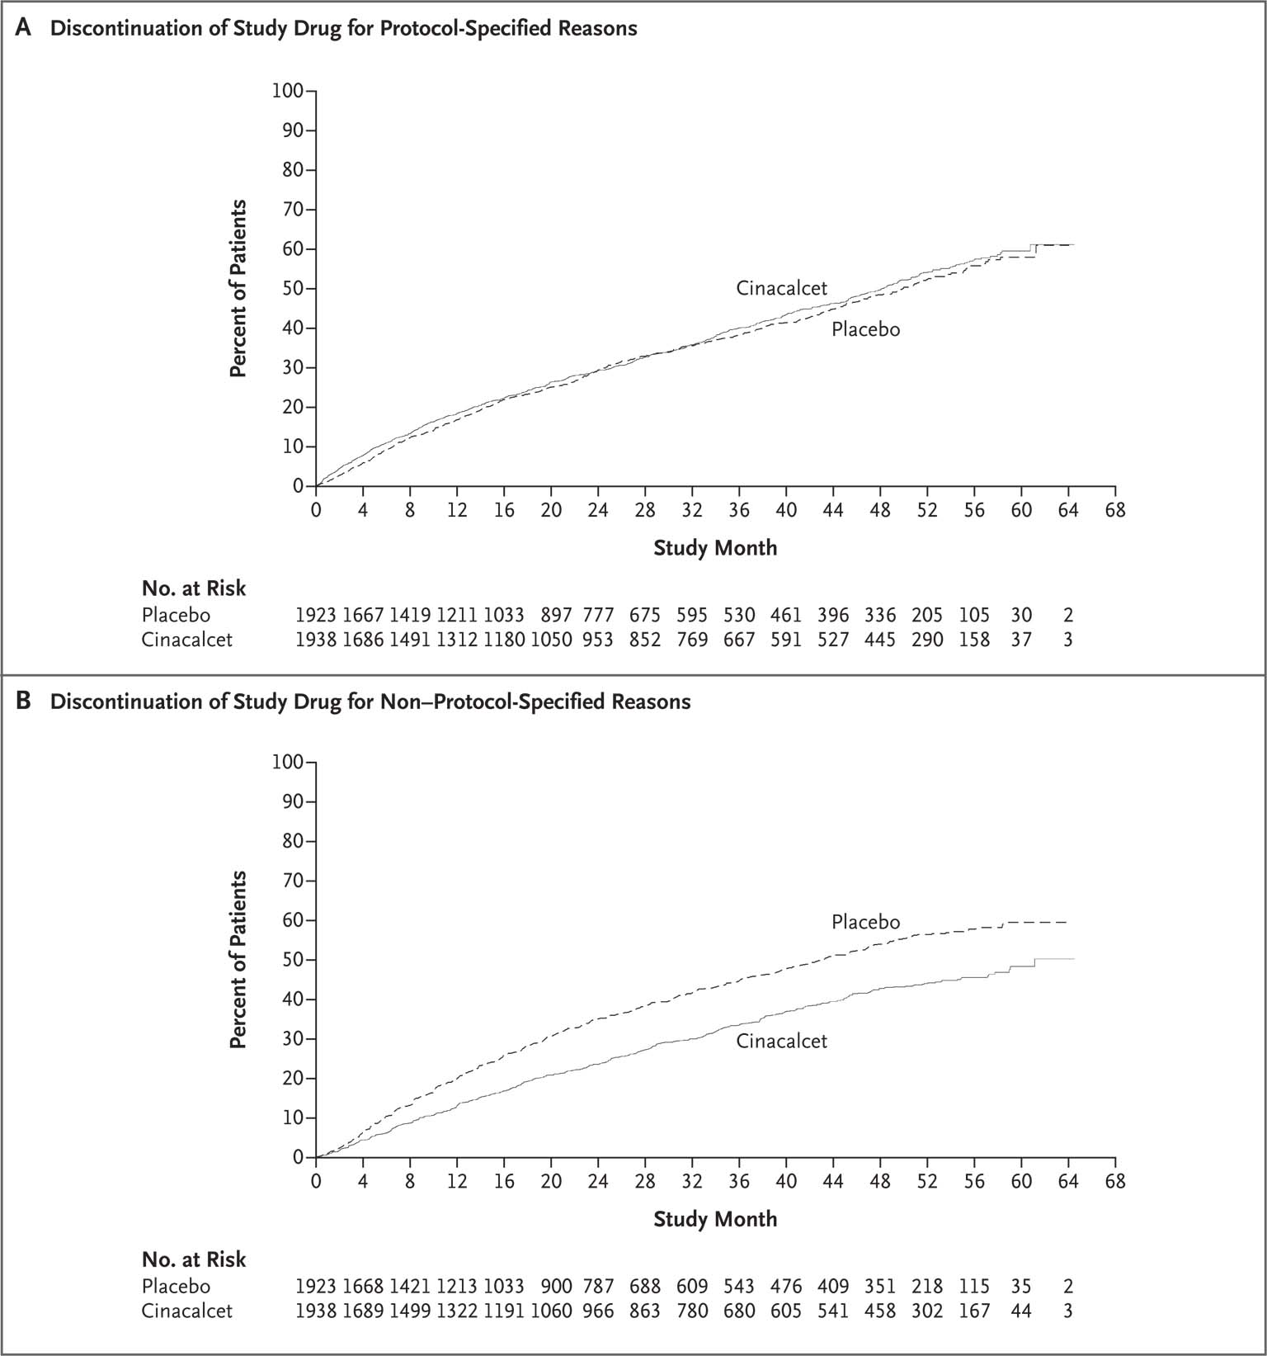
Cumulative Incidence of Study-Drug Discontinuation in the As-Treated Population.
The EVOLVE Trial Investigators. N Engl J Med 2012;367:2482-2494
Notes:
Figure 2 Cumulative Incidence of Study-Drug Discontinuation in the As-Treated Population. Shown are Kaplan–Meier curves comparing cinacalcet with placebo with respect to the time to discontinuation of a study drug for protocol-specified reasons (Panel A) and non–protocol-specified reasons (Panel B).

Slide 19
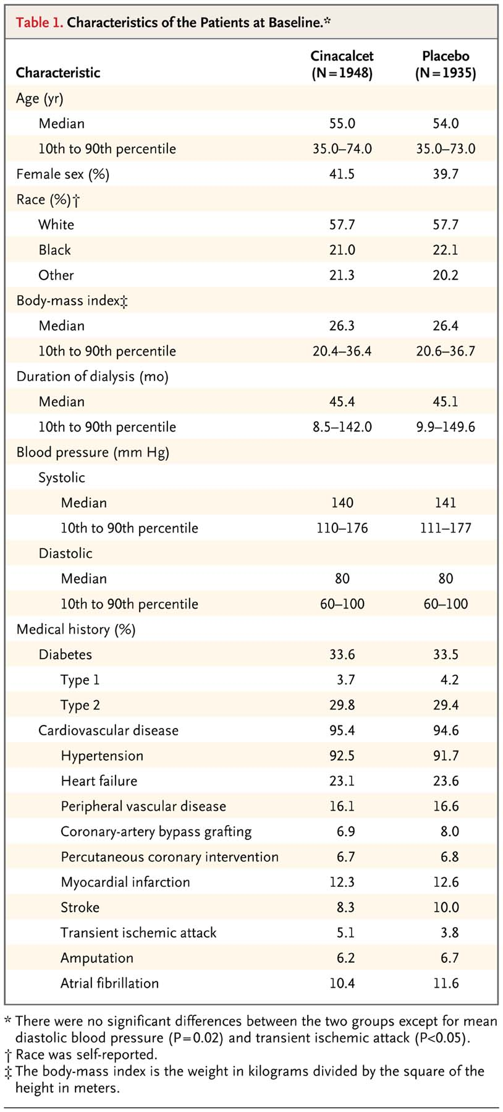
Characteristics of the Patients at Baseline
The EVOLVE Trial Investigators. N Engl J Med 2012;367:2482-2494
Notes:
Table 1 Characteristics of the Patients at Baseline.

Slide 20
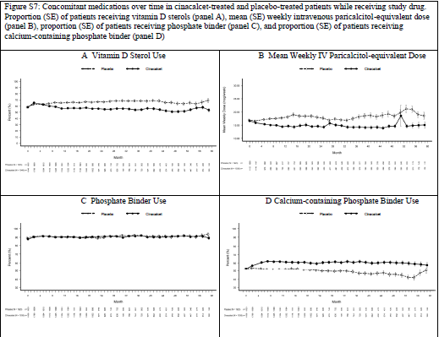
Concomitant Medication Over Time in the Randomized Groups

Slide 21
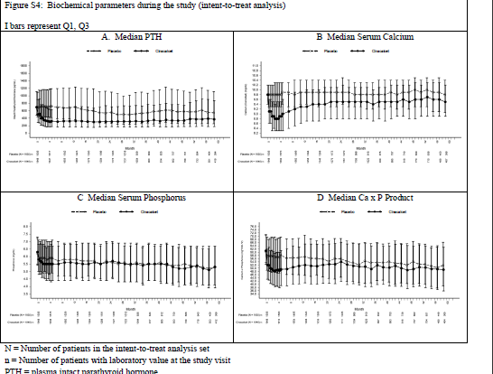
Biochemical Parameters during the Study

Slide 22
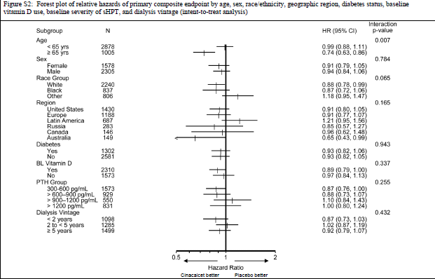
Forest plot of Relative Hazards

Slide 23
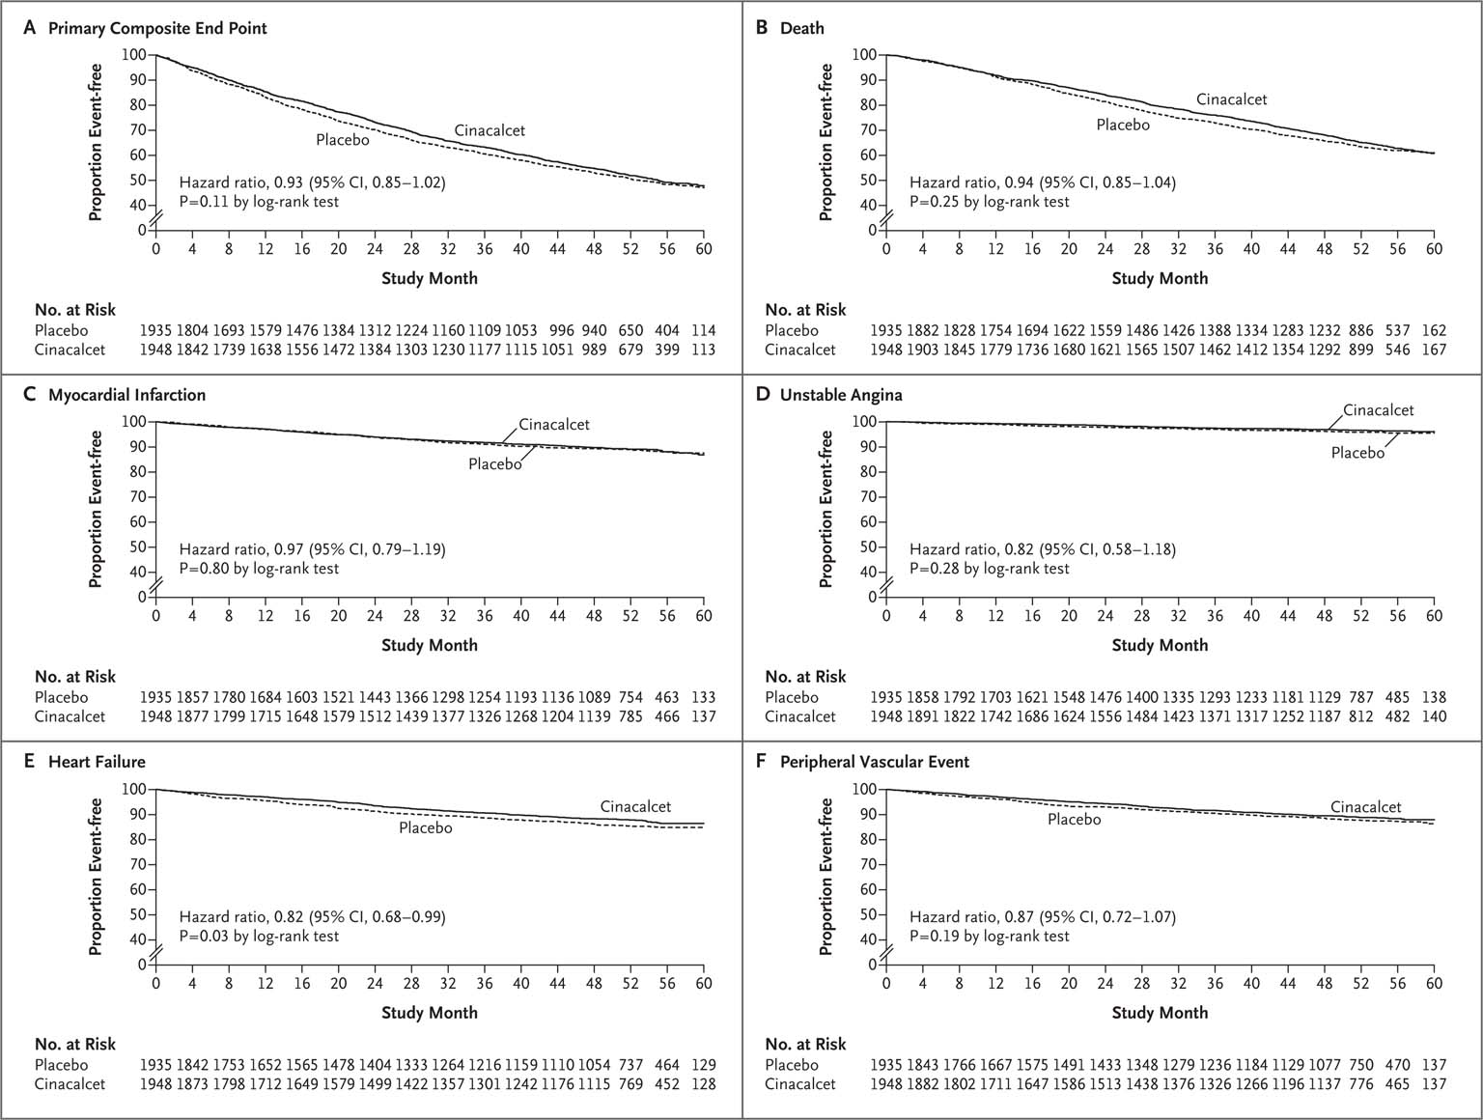
Intention-to-Treat Analysis of the Primary Composite Outcome and Its Components
The EVOLVE Trial Investigators. N Engl J Med 2012;367:2482-2494
Notes:
Figure 3 Intention-to-Treat Analysis of the Primary Composite Outcome and Its Components. Shown are Kaplan–Meier curves comparing cinacalcet with placebo for the time to the first primary composite outcome (Panel A), death (Panel B), first myocardial infarction (Panel C), first hospitalization for unstable angina (Panel D), first episode of heart failure (Panel E), and first episode of a peripheral vascular event (Panel F).

Slide 24
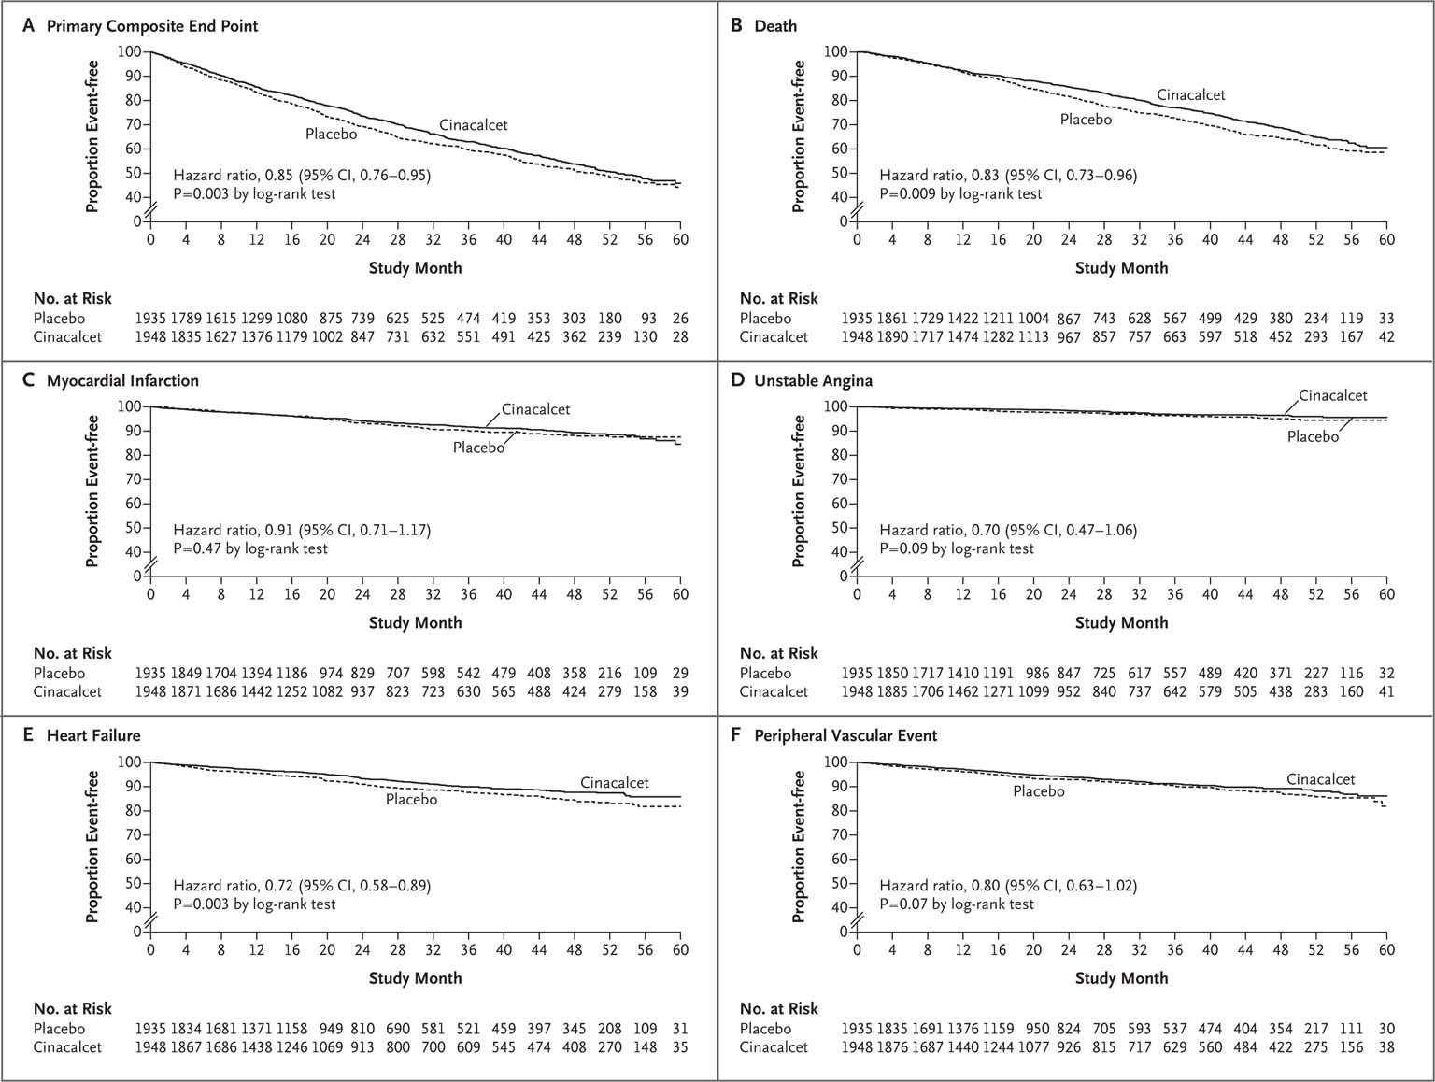
Lag-Censoring Analysis of the Primary Composite Outcome and Its Components
Notes:
Figure 4 Lag-Censoring Analysis of the Primary Composite Outcome and Its Components. Shown are Kaplan–Meier curves comparing cinacalcet with placebo for the time to the first primary composite outcome (Panel A), death (Panel B), first myocardial infarction (Panel C), first hospitalization for unstable angina (Panel D), first episode of heart failure (Panel E), and first episode of a peripheral vascular event (Panel F).

Slide 25
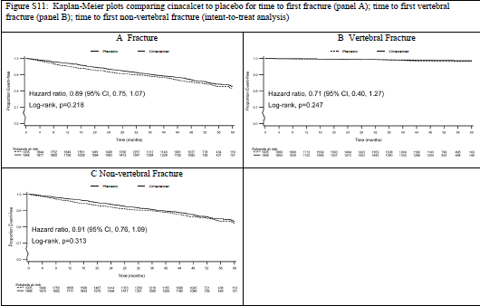
Kaplan – Meier Plots for Secondary End points

Slide 26
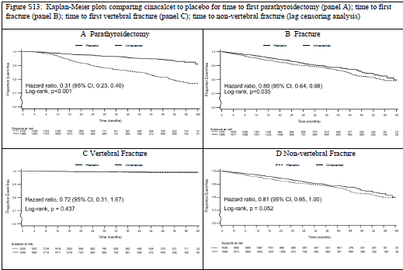
Kaplan – Meier Plots for Secondary End points

Slide 27
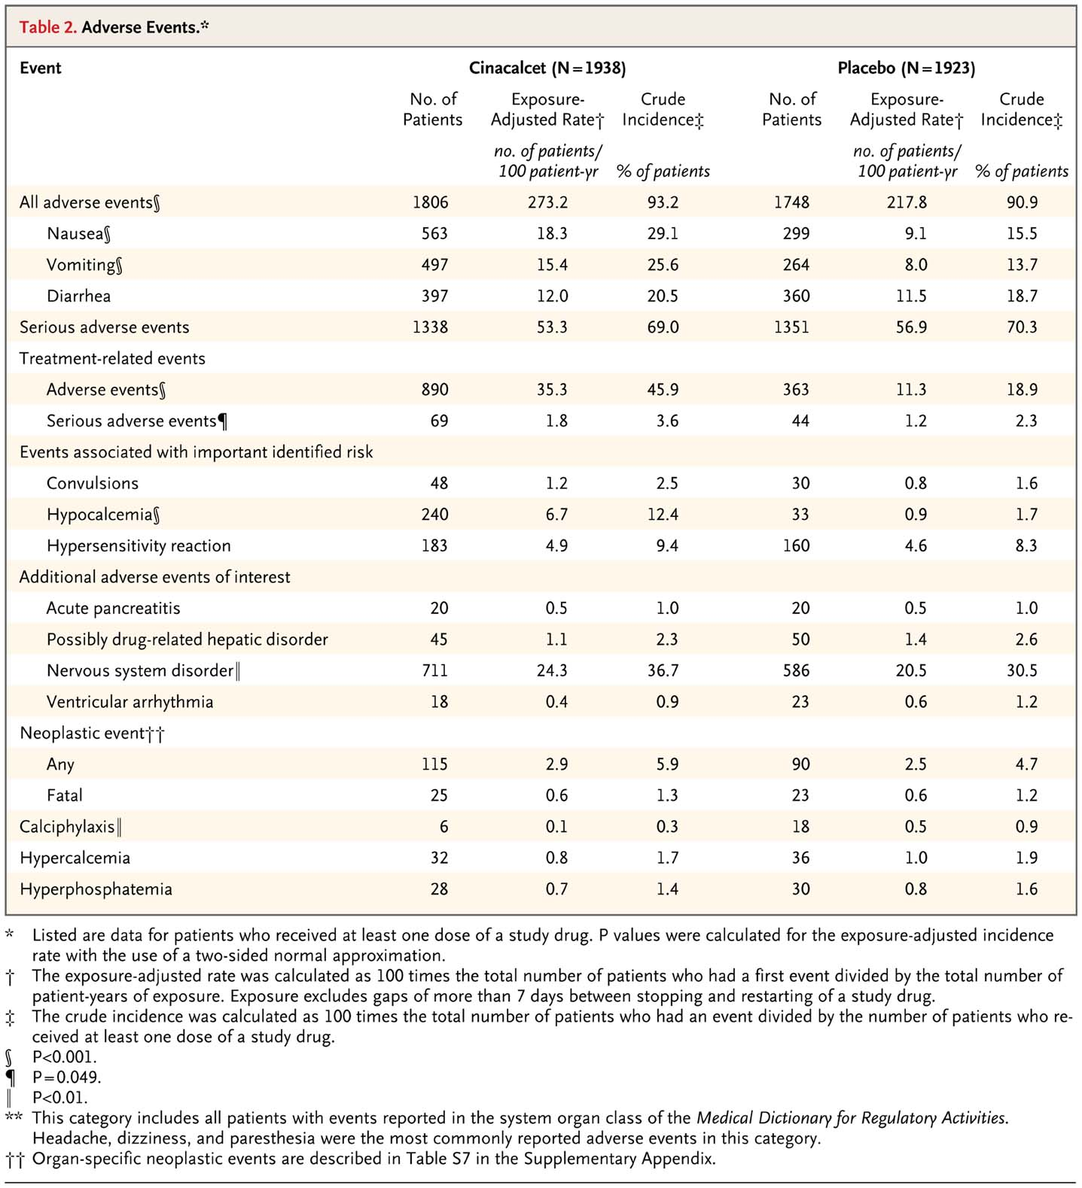
Adverse Events
Notes:
Table 2 Adverse Events.

Slide 28
Discussion
Strength of the study
Multicenter double blind placebo controlled study involving many geographic regions
Diversity in terms of age, race and underlying kidney and cardiovascular disease
Patients who were assigned to receive either Cinacalcet or Placebo were all eligible to
receive active therapy for mineral and bone disease including phosphate binders and
Vitamin D sterols
All cardiovascular events were independently adjudicated and relatively few patients
were lost on follow up

Slide 29
Study Limitations
Statistical power was hampered by a lower than anticipated event rate
Statistical power was reduced further since 1 in 5 patients in the placebo
group were prescribed commercially available Cinacalcet
Observed baseline imbalances between randomized group-age which is
the most potent predictor of death or cardiovascular events

Slide 30
Conclusion
In an unadjusted intention-to-treat analysis, cinacalcet did not significantly reduce the risk of death or major cardiovascular events in patients with moderate to severe secondary hyperparathyroidism who were undergoing dialysis

Slide 31
“ There is nothing like looking, if you want to find something. You certainly usually find something, if you look, but it is not always quite the something you were after ” - Voltaire
Thank You

