Slide 1
Ultrafiltration in Decompensated Heart Failure with Cardiorenal Syndrome
Girish Singhania
N Engl J Med 2012

Slide 2
BACKGROUND
Ultrafiltration is an alternative strategy to diuretic therapy for the treatment of patients with acute decompensated heart failure.
Little is known about the efficacy and safety of ultrafiltration in patients with acute decompensated heart failure complicated by persistent congestion and worsened renal function.

Slide 3
Study Design: Inclusion Criteria
Admitted to the hospital with a primary diagnosis of decompensated heart failure
Onset of cardiorenal syndrome after hospitalization or pre-hospitalization
after hospitalization—onset of cardiorenal syndrome after hospitalization must occur within 10 days from the time of admission after receiving IV diuretics
pre-hospitalization—onset of cardiorenal syndrome pre-hospitalization must occur within 12 weeks of the index hospitalization in the setting of escalating doses of outpatient diuretics

Slide 4
Persistent volume overload
For patients with a pulmonary artery catheter, persistent volume overload will include:
Pulmonary capillary wedge pressure greater than 22mmHg and one of the following clinical signs: at least 2+ peripheral edema and/or pulmonary edema or pleural effusions on chest x-ray
For patients without a pulmonary artery catheter, persistent volume overload will include at least two of the following:
At least 2+ peripheral edema, jugular venous pressure greater than 10 cm on physical examination (or central venous pressure greater than 10 mmHg when measured), pulmonary edema or pleural effusions on chest x-ray

Slide 5
Exclusion criteria:
Intravascular volume depletion based on investigator’s clinical assessment
Acute coronary syndrome within 4 weeks
Indication for hemodialysis or creatinine > 3.5 mg per deciliter at admission.
Systolic blood pressure < 90 mmHg at the time of enrollment
Alternative explanation for worsening renal function such as obstructive nephropathy, Contrast induced nephropathy, acute tubular necrosis
Hematocrit > 45%
Clinical instability likely to require IV vasoactive drugs, vasodilators or inotropic agents.
Allergy or contraindications to the use of heparin
Known bilateral renal artery stenosis
Active myocarditis or hypertrophic obstructive cardiomyopathy, severe valvular stenosis or complex congenital heart disease
Sepsis or ongoing systemic infection

Slide 6
Patients were randomly assigned, in a 1:1 ratio, to either ultrafiltration therapy or pharmacologic therapy.

Slide 7
AT RANDOMIZATION – STEPPED PHARMACOLOGIC CARE ARM

Slide 10
Ultrafiltration
For patients assigned to ultrafiltration therapy, loop diuretics were to be discontinued for the duration of the ultrafiltration intervention.
Fluid status was managed by means of ultrafiltration with the use of the Aquadex System 100 (CHF Solutions) according to the manufacturer's specifications.
Ultrafiltration was performed at a fluid-removal rate of 200 ml per hour.
The addition of intravenous vasodilators or positive inotropic agents after randomization was prohibited unless they were deemed to be necessary as rescue therapy.

Slide 11
Primary End Point
Change in serum creatinine AND weight together as a “bivariate” endpoint assessed 96 hours after enrollment.

Slide 12
Secondary End Points
Primary endpoint assessed after randomization on hospital days 1 - 3 , 7, 30 and 60.
Treatment failure during the first seven days after randomization.
Changes in electrolytes from randomization to 96 hours and one week.
Percent of patients achieving clinical decongestion (JVP < 8, No edema or orthopnea) at 96 hours, one week, 30 and 60 days.
Total net fluid loss from randomization to 96 hours and 1 week.
Length of hospital stay, days alive outside the hospital at 60 days, and heart failure rehospitalizations during the 60 day.
Changes in daily oral diuretic doses from prior to hospitalization to discharge, at 30 and at 60 days.

Slide 14
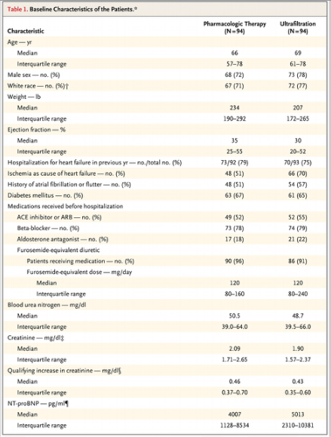

Slide 15
Study Treatments
The median duration of the stepped pharmacologic-therapy intervention was 92 hours.
The best possible fluid volume was reached (72% of the patients), the creatinine level was increased (12%), there was evidence of intravascular volume depletion (3%), and blood pressure dropped or clinical instability developed (2%).
46% of the participants in the pharmacologic-therapy group received treatment with metolazone within the first 7 days, 5% were treated with IV vasodilators, and 12% were treated with IV inotropic agents before the day 4 assessment.

Slide 16
Ultrafiltration was started a median of 8 hours and the median duration of the treatment was 40 hours.
The best possible fluid volume was reached (50% of the patients), the creatinine level was increased (16%), difficulties developed with vascular access (9%), and thrombosis of the ultrafiltration circuit developed (9%).
9% received IV diuretics instead of ultrafiltration, and an additional 30% received IV diuretics after ultrafiltration was stopped and before the 96-hour assessment.
3% of the patients received vasodilators and 3% received IV inotropic agents before the day 4 assessment.

Slide 17
Result: Primary End Point

Slide 22
Discussion
Strengths of the study:
Multicenter randomized controlled trial.
Primary end point includes two most common things we check routinely.
Most of the patients enrolled in study completed the study.

Slide 23
Study limitations
The treatment assignments were not blinded, and biases on the part of study investigators may have affected the duration or relative intensity of ultrafiltration and pharmacologic therapy.
Not enough patients in each group.
Although there is significant difference in creatinine at 96 hours but no significant difference in cystatin C or GFR.
Aquadex System 100 ultrafiltration procedure doesn’t remove creatinine and in the ultrafiltration group most of the fluid was removed with ultrafiltration compared to pharmacological group where it was removed through kidneys.

Slide 25
A total of 12% of patients in the pharmacologic-therapy group received inotropic agents, which are prohibited in ultrafiltration; this may have attenuated hypotension-related worsening renal function.
A total of 23% of patients in the ultrafiltration group crossed over to alternative therapy, and 39% received intravenous diuretics before the 96-hour assessment, which may have contributed to worsening renal function.
Changes in hematocrit may be a useful surrogate for measuring the plasma refill rate during ultrafiltration therapy but it was not measured.

Slide 26
CONCLUSION
In a randomized trial involving patients hospitalized for acute decompensated heart failure, worsened renal function, and persistent congestion, the use of a stepped pharmacologic-therapy algorithm was superior to a strategy of ultrafiltration for the preservation of renal function at 96 hours, with a similar amount of weight loss with the two approaches.

Slide 27
Thank you

